Slide 1

C H A P T E R O U T L I N E
Elasticity
Price Elasticity of Demand
Slope and Elasticity
Types of Elasticity
Calculating Elasticities
Calculating Percentage Changes
Elasticity Is a Ratio of Percentages
The Midpoint Formula
Elasticity Changes Along a Straight-Line Demand Curve
Elasticity and Total Revenue
Other Important Elasticities
Income Elasticity of Demand
Cross-Price Elasticity of Demand
Elasticity of Supply

Slide 2
elasticity A general concept used to quantify the response in one variable when another variable changes.

Slide 3
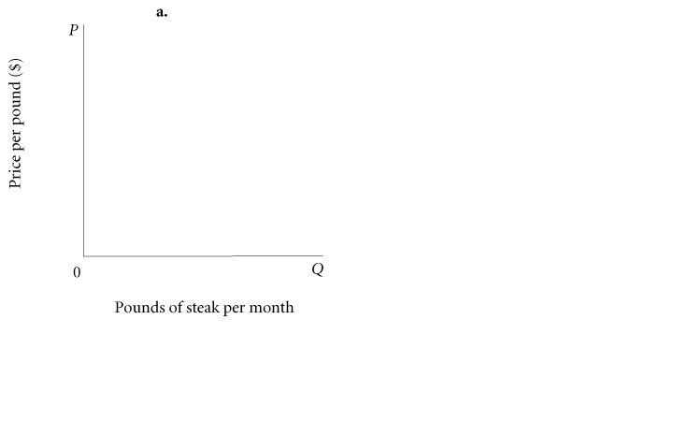
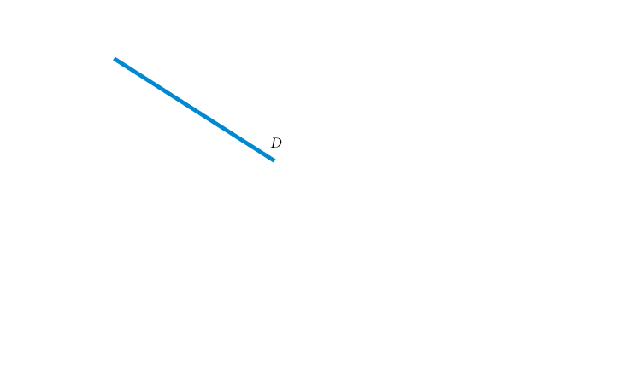
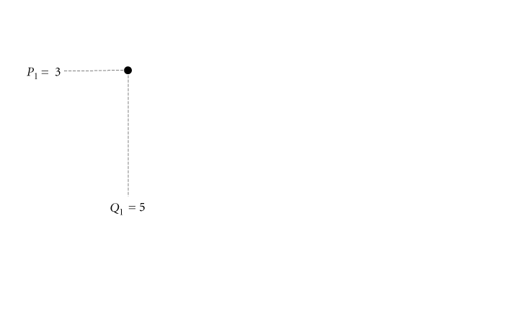
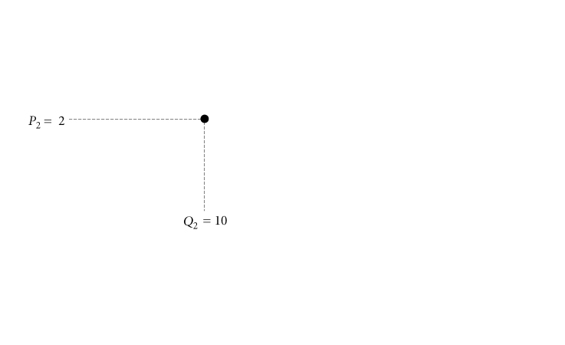
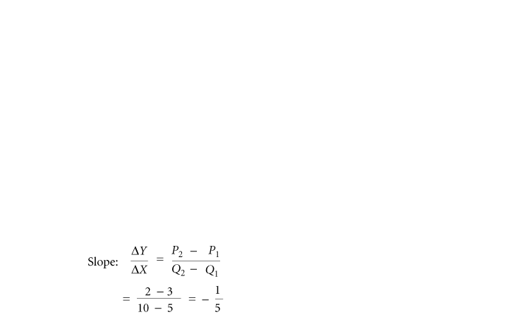
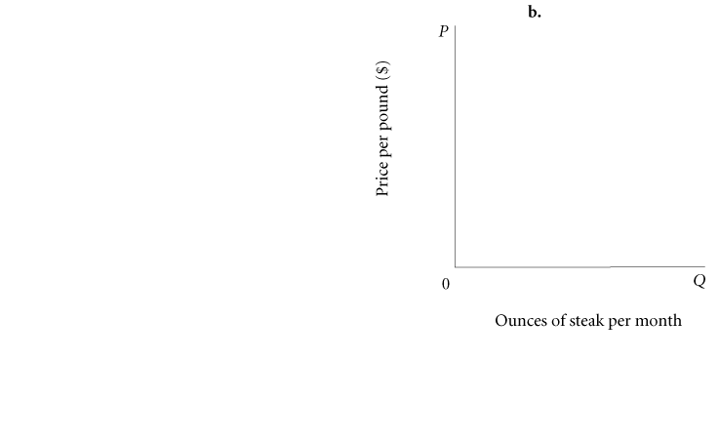
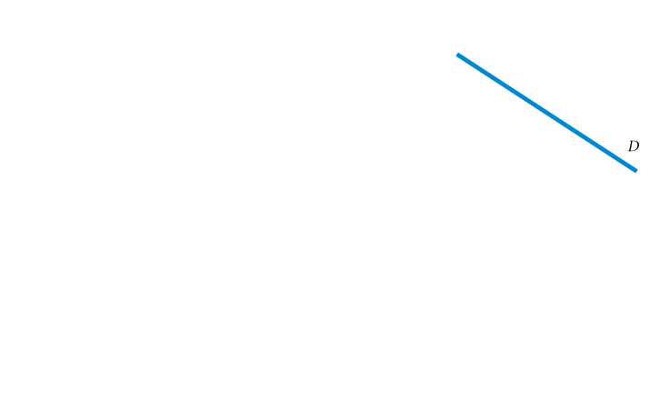
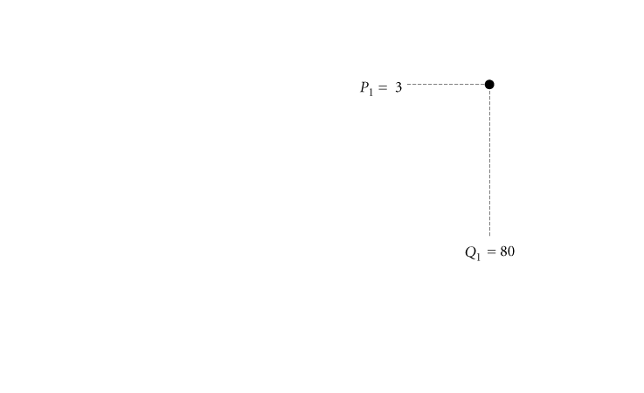
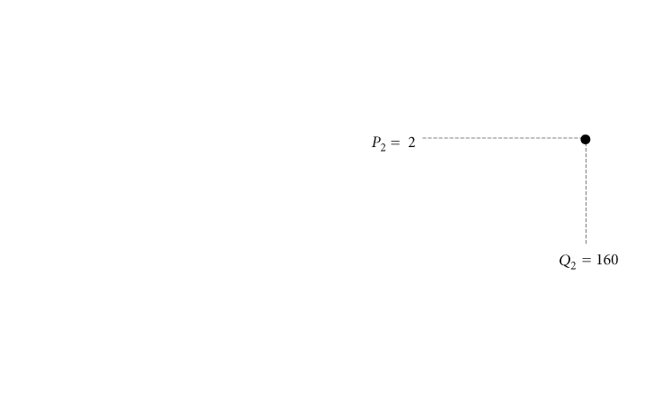
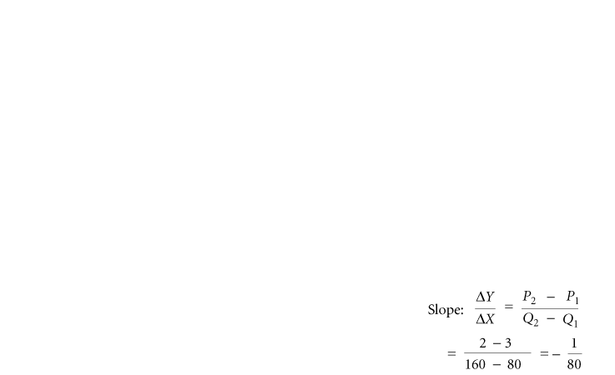
Price Elasticity of Demand
Slope and Elasticity
① FIGURE 5.1 Slope Is Not a Useful Measure of Responsiveness
Changing the unit of measure from pounds to ounces changes the numerical value of the demand slope dramatically, but the behavior of buyers in the two diagrams is identical.

Slide 4
price elasticity of demand The ratio of the percentage of change in quantity demanded to the percentage of change in price; measures the responsiveness of quantity demanded to changes in price.

Slide 5
Types of Elasticity
perfectly inelastic demand Demand in which quantity demanded does not respond at all to a change in price.
perfectly elastic demand Demand in which quantity drops to zero at the slightest increase in price.

Slide 6
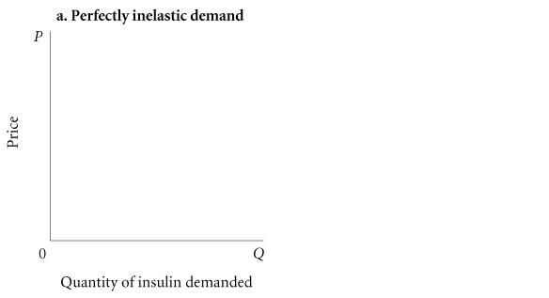
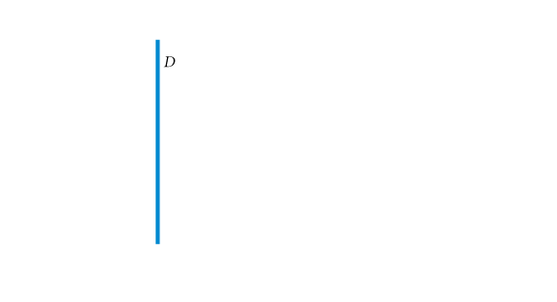
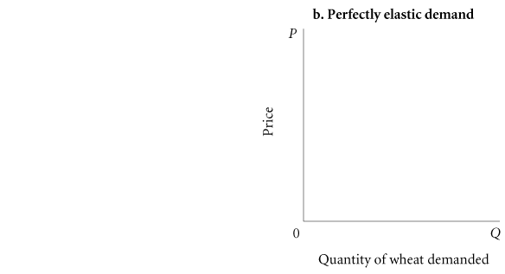
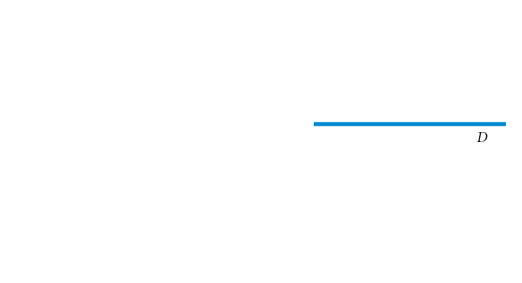
① FIGURE 5.2 Perfectly Inelastic and Perfectly Elastic Demand Curves
Figure 5.2(a) shows a perfectly inelastic demand curve for insulin.
Price elasticity of demand is zero.
Quantity demanded is fixed; it does not change at all when price changes.
Figure 5.2(b) shows a perfectly elastic demand curve facing a wheat farmer.
A tiny price increase drives the quantity demanded to zero.
In essence, perfectly elastic demand implies that individual producers can sell all they want at the going market price but cannot charge a higher price.

Slide 7
elastic demand A demand relationship in which the percentage change in quantity demanded is larger than the percentage change in price in absolute value (a demand elasticity with an absolute value greater than 1).
inelastic demand Demand that responds somewhat, but not a great deal, to changes in price. Inelastic demand always has a numerical value between zero and 1.
unitary elasticity A demand relationship in which the percentage change in quantity of a product demanded is the same as the percentage change in price in absolute value (a demand elasticity of 1).
A warning:
You must be very careful about signs. Because it is generally understood that demand elasticities are negative (demand curves have a negative slope), they are often reported and discussed without the negative sign.

Slide 8
Calculating Elasticities
Calculating Percentage Changes
To calculate percentage change in quantity demanded using the initial value as the base, the following formula is used:

Slide 9
We can calculate the percentage change in price in a similar way. Once again, let us use the initial value of P—that is, P₁—as the base for calculating the percentage. By using P₁ as the base, the formula for calculating the percentage of change in P is

Slide 10
Elasticity Is a Ratio of Percentages
Once the changes in quantity demanded and price have been converted to percentages, calculating elasticity is a matter of simple division. Recall the formal definition of elasticity:

Slide 11
The Midpoint Formula
midpoint formula A more precise way of calculating percentages using the value halfway between P₁ and P₂ for the base in calculating the percentage change in price and the value halfway between Q₁ and Q₂ as the base for calculating the percentage change in quantity demanded.

Slide 12
Point Elasticity
point elasticity A measure of elasticity that uses the slope measurement.
We have defined elasticity as the percentage change in quantity demanded divided by the percentage change in price. We can write this as
Where ∆ denotes a small change and Q₁ and P₁ refer to the original price and quantity demanded.
This can be rearranged and written as
Notice that ∆Q/∆P is the reciprocal of the slope.

Slide 13
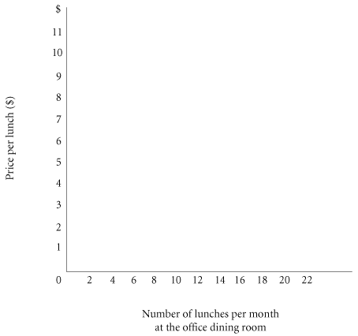
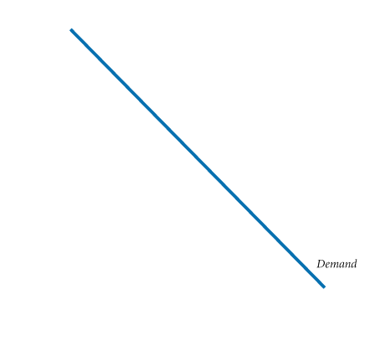
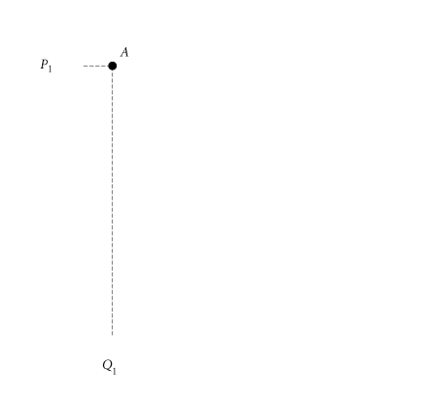
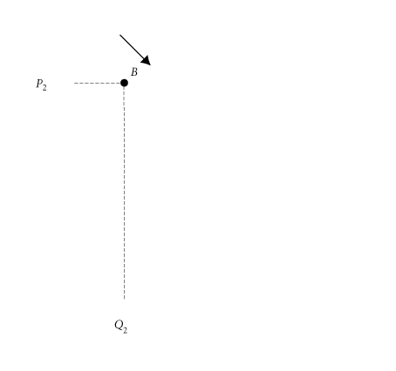
Elasticity Changes Along a Straight-Line Demand Curve
TABLE 5.1 Demand Schedule for Office Dining Room Lunches
Price (per Lunch) | Quantity Demanded (Lunches per Month)
$11 10 9 8 7 6 5 4 3 2 1 0 | 0 2 4 6 8 10 12 14 16 18 20 22
② FIGURE 5.3 Demand Curve for Lunch at the Office Dining Room
To calculate price elasticity of demand between points A and B on the demand curve, first calculate the percentage change in quantity demanded:

Slide 14
Elasticity Changes Along a Straight-Line Demand Curve
TABLE 5.1 Demand Schedule for Office Dining Room Lunches
Price (per Lunch) | Quantity Demanded (Lunches per Month)
$11 10 9 8 7 6 5 4 3 2 1 0 | 0 2 4 6 8 10 12 14 16 18 20 22
② FIGURE 5.3 Demand Curve for Lunch at the Office Dining Room
Next, calculate the percentage change in price:

Slide 15
Elasticity Changes Along a Straight-Line Demand Curve
TABLE 5.1 Demand Schedule for Office Dining Room Lunches
Price (per Lunch) | Quantity Demanded (Lunches per Month)
$11 10 9 8 7 6 5 4 3 2 1 0 | 0 2 4 6 8 10 12 14 16 18 20 22
② FIGURE 5.3 Demand Curve for Lunch at the Office Dining Room
Finally, calculate elasticity:

Slide 16
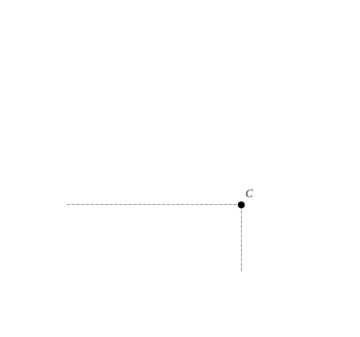
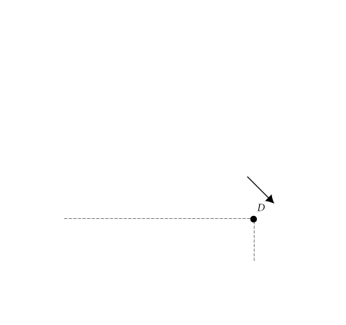
Elasticity Changes Along a Straight-Line Demand Curve
TABLE 5.1 Demand Schedule for Office Dining Room Lunches
Price (per Lunch) | Quantity Demanded (Lunches per Month)
$11 10 9 8 7 6 5 4 3 2 1 0 | 0 2 4 6 8 10 12 14 16 18 20 22
② FIGURE 5.3 Demand Curve for Lunch at the Office Dining Room
Between points A and B, demand is quite elastic at −6.33.
Between points C and D, demand is quite inelastic at −.294. (You can work this number out for yourself using the midpoint formula.)

Slide 17
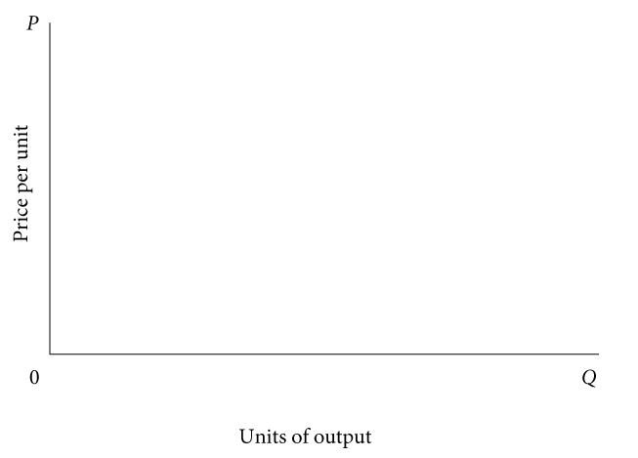
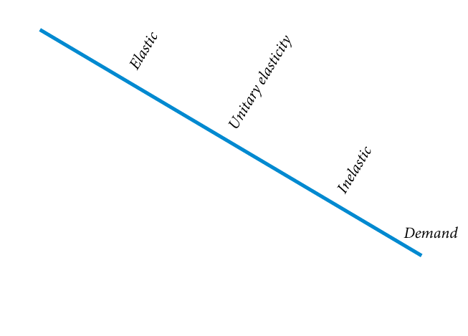
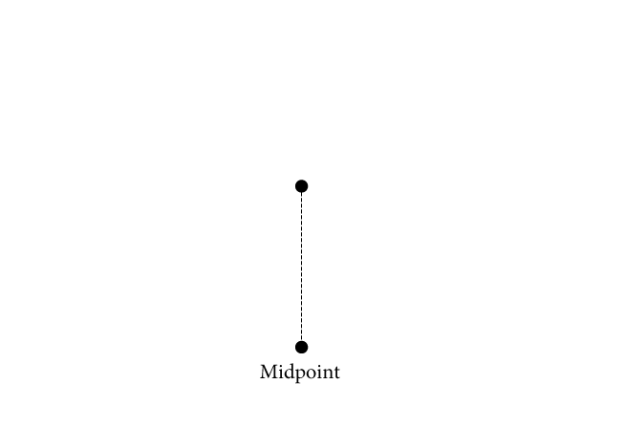
② FIGURE 5.4 Point Elasticity Changes Along a Demand Curve

Slide 18
Elasticity and Total Revenue
In any market, P × Q is total revenue (TR) received by producers:
TR = P × Q total revenue = price × quantity
When price (P) declines, quantity demanded (Q_{D}) increases. The two factors, P and Q_{D}, move in opposite directions:
effects of price changes on quantity demanded:

Slide 19
Because total revenue is the product of P and Q, whether TR rises or falls in response to a price increase depends on which is bigger: the percentage increase in price or the percentage decrease in quantity demanded.
effect of price increase on a product with inelastic demand:
If the percentage decline in quantity demanded following a price increase is larger than the percentage increase in price, total revenue will fall.
effect of price increase on a product with elastic demand:

Slide 20
The opposite is true for a price cut. When demand is elastic, a cut in price increases total revenues:
effect of price cut on a product
with elastic demand:
When demand is inelastic, a cut in price reduces total revenues:
effect of price cut on a product
with inelastic demand:

Slide 21
Other Important Elasticities
Income Elasticity of Demand
income elasticity of demand A measure of the responsiveness of demand to changes in income.
Cross-Price Elasticity of Demand
cross-price elasticity of demand A measure of the response of the quantity of one good demanded to a change in the price of another good.

Slide 22
Elasticity of Supply
elasticity of supply A measure of the response of quantity of a good supplied to a change in price of that good. Likely to be positive in output markets.
elasticity of labor supply A measure of the response of labor supplied to a change in the price of labor.

